Slide 1
Recent Developments in Algebraic & Proof Complexity Iddo Tzameret Tsinghua Univ. Based on Hrubes and T. [CCC ‘09, STOC ’12]

Slide 2
Propositional proofs
Take any standard textbook proof systems: Frege, sequent calculus, Hilbert style, Natural deduction…
It doesn’t matter!

Slide 3
Example of propositional proof
Aᴠ¬A
axiom
Bᴠ¬B
F
FᴠX
(Aᴠ¬A)ᴠB
(Bᴠ¬B)ᴠA
(AᴠB) ᴠ¬A
commutativity
(BᴠA)ᴠ¬B
FᴠX FᴠY
Fᴠ(XΛY)
(AᴠB) ᴠ (¬A Λ¬B)
Notes:
4’

Slide 4
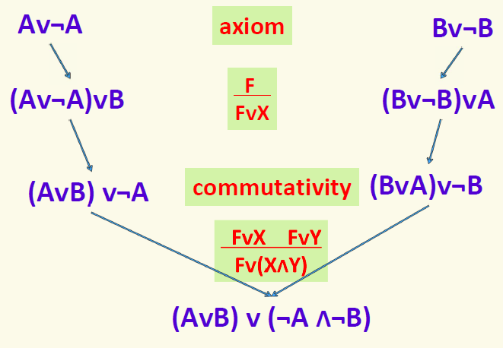
Complexity of proofs
Size of proof = number of symbols it takes to write down the proof
(= total size of all formulas in proof)
Example:
Size: 41
Fact: Every two Frege/sequent-proofs are polynomially equivalent!
Notes:
7

Slide 5
Complexity of Proofs
Fundamental open problem in logic & complexity:
Prove super-polynomial lower bounds on propositional proofs!
Prove that there is a family {f₁,f₂,f₃,…} of tautologies s.t. for no polynomial p(∙): MinProofSize(f_{i}) ≤ p(|f_{i}|)
Notes:
6’
Motivations: understand the circuit based Frege hierarchy; separations, possible separations, understand better analogy with circuit complexity, if any.
--Note: the rules have to be slightly accommodated when speaking about circuits and not formulas: the similarity rule
- Don’t require poly-size for NC2-Frege proofs

Slide 6
Complexity of Proofs
TAUT is coNP complete
Motivation:
Advance towards NP≠coNP
SAT solving
3. Connections between efficient proofs and efficient computations
Computing functions (e.g., determinants)
Proving statements (e.g., properties of determinants)
Notes:
9’
Motivations: understand the circuit based Frege hierarchy; separations, possible separations, understand better analogy with circuit complexity, if any.
--Note: the rules have to be slightly accommodated when speaking about circuits and not formulas: the similarity rule

Slide 7
Circuit based proofs
Think of every proof-line as a circuit:
NC¹ circuits: poly(n) size, O(log n) depth
NC¹-Frege (=Frege): proof-lines are formulas
NC² circuits: poly(n) size, O(log²n) depth
NC²-Frege: O(log²n) depth proof-lines
P/poly circuits: poly(n) size
P/poly-Frege (=eFrege): proof-lines are circuits
Notes:
6’
Motivations: understand the circuit based Frege hierarchy; separations, possible separations, understand better analogy with circuit complexity, if any.
--Note: the rules have to be slightly accommodated when speaking about circuits and not formulas: the similarity rule
- Don’t require poly-size for NC2-Frege proofs

Slide 8
Frege Hierarchy
P/poly-Frege
all proof lines are circuits
NC²-Frege
all proof lines are depth O(log²(n)) circuits
NC¹-Frege
all proof lines are depth O(log(n)) circuits= formulas
Useful analogy; understand the Frege hierarchy: lower/upper bounds
Notes:
7

Slide 9
Case study: linear algebra
Determinant in NC²
Can we prove properties of determinant with poly-size NC²-Frege proofs ?
Conjecture: “Yes!” (Cook; Rackoff; Bonet, Buss & Pitassi; Soltys)
Specifically: AB=I→BA=I has no short NC¹-proofs
Previous work: Soltys and Cook (‘04): poly-size P/poly-Frege proofs
Notes:
11’
Which determinant in NC2 over gf(2)?
Philosophy of analogy between circuits and proofs

Slide 10
Case study: linear algebra
Determinant conjectured not in NC¹
Conjecture: Properties of determinant outside poly-size NC¹-Frege proofs.
Notes:
11’
Which determinant in NC2 over gf(2)?
Philosophy of analogy between circuits and proofs

Slide 11
The
Algebraic World

Slide 12
Algebraic circuits
Fix a field F
An algebraic circuit over F
computes a formal
polynomial over F
(x₁+x₂)∙(x₂+3)= x₁x₂+x₂²+3x₁+3x₂
Size = number of nodes
^{output}
˟
+
+
x₁
x₂
3
Notes:
14’ Differs from computing Boolean functions
These statements can be encoded in the obvious way as n^2 equations
Hard= super-polynomial size lower bounds
Conj 2 also yields a quasipolynomial Frege proof

Slide 13
Proof systems in the algebraic world?
Proofs of polynomial identities:
F=G
For F,G algebraic circuits
E.g.: (x₁+x₂)∙(x₂+3) = x₁x₂+x₂x₂+3x₁+3x₂
BPP language (unlike TAUT in coNP)
Note: not (algebraic) propositional proofs!
Notes:
Propositional algebraic proofs already established.

Slide 14
Arithmetic proofs
Proof-lines: equations between algebraic circuits
Axioms: polynomial-ring axioms; f+g=g+f, etc.
Rules: Transitivity of “=“; +,x introduction, etc.
Circuit-axiom: F=G, if F and G are identical when the circuits unwinded into trees
Start from axioms and derive new identities by derivation rules:
field identities axiom
2∙3=6
x=x
reflexivity axiom
product rule
commutativity axiom
3x∙2=2∙3x
2∙3x=6x
transitivity
3x∙2=6x
Notes:
15’

Slide 15
Motivations
Relations to polynomial identity testing
We shall see:
Relations to propositional proofs!
Notes:
18’
Give the exact statement of Valiant et al for proof
--What is the exact formulation of Homeginization thm for proofs? What about the syntactic degree?

Slide 16
The theory of arithmetic proofs
[Hrubes, T. CCC ’09]:
Proof-lines: equations between formulas (and more restricted circuits):
Short Bounded depth proofs for interesting families of polynomial identities:
Symmetric polynomials;
Vandermonde matrices identities
Lower bounds on very restrictive proofs
Notes:
18’
Give the exact statement of Valiant et al for proof
--What is the exact formulation of Homeginization thm for proofs? What about the syntactic degree?

Slide 17
The theory of arithmetic proofs
[Hrubes, T. STOC ’12]:
Proof-lines: equations between circuits
Structural results for algebraic circuits carry over to arithmetic proofs
Eliminate high degrees (Strassen '73)
Division elimination (Strassen '73, HrubeŠ, Yehudayoff '11)
Arithmetic-P/poly = Arithmetic-NC² (Valiant, Skyum, Berkowitz and Rackoff '83)
Notes:
18’
Give the exact statement of Valiant et al for proof
--What is the exact formulation of Homeginization thm for proofs? What about the syntactic degree?

Slide 18
1. Eliminate high degrees
Syntactic-degree of G:
expand all terms in G, without canceling terms!
Syntactic-degree = maximal degree of a term.
Example: x(1+y⁵⁰)-xy⁵⁰
Expansion: x+xy⁵⁰-xy⁵⁰
Syntactic-degree: 51
Notes:
Give the exact statement of Valiant et al for proof
--What is the exact formulation of Homeginization thm for proofs? What about the syntactic degree?

Slide 19
1. Eliminate high degrees
Thm: Let G,F be of syntactic-degree ≤d. Then proving G=F using proof-lines with syntactic-degrees higher than d cannot help reducing size.
Example:
for proving x(1+y⁵⁰)-xy⁵⁰=x, terms with degree ≥51 won’t help!
Notes:
Give the exact statement of Valiant et al for proof
--What is the exact formulation of Homeginization thm for proofs? What about the syntactic degree?

Slide 20
2. Eliminate Division gates
We can extend our language to have division gates (apart from +,x): f/g computes the rational function f/g.
We add the axiom: f∙f⁻¹=1, for any f≠0; We call the resulting proof: proof with division
Thm: Assume F=G is true identity without division gates. Then any proof with division of F=G can be transformed into a proof of F=G without divisions, with only polynomial increase in size.
Notes:
Give the exact statement of Valiant et al for proof
--What is the exact formulation of Homeginization thm for proofs? What about the syntactic degree?

Slide 21
3. Balancing proofs
Balancing circuits (Valiant et al.): G a circuit with size s and degree poly(n) ➔ can transform G into circuits [G] of size poly(s) and depth O(log²n) (computing same polynomial)
Balancing proofs: F,G: circuits with syntactic-degree poly(n). Then, poly(n)-size arithmetic proof of F=G ➔ transforms into poly(n)-size and O(log²n)-depth arithmetic proof of [F]=[G].
Notes:
Give the exact statement of Valiant et al for proof
--What is the exact formulation of Homeginization thm for proofs? What about the syntactic degree?

Slide 22
Applications

Slide 23
Recall question: Can we prove properties of determinant with poly-size NC²-Frege proofs ?
Now we can answer “yes”…..
Notes:
Give the simple block construction

Slide 24
(Hrubes T. 2012): Arithmetic proofs of:
Det(A)∙Det(B)=Det(A∙B)
Det(C)=c₁₁∙c₂₂∙∙∙c_{nn}
for any A,B,C nxn matrices and Det(∙) the
determinant function, and C triangular
These are poly(n) size proofs operating with equalities between algebraic circuits of O(log²n)-depth
Corollary: short propositional NC²-Frege proofs
Notes:
13’
Most constructive proof of linear algebra (conjectured to be optimal);
Gives a better understanding of the Frege Hierarchy;
Strengthens the connection between provability and computation;
Feasible mathematic.
These statements can be encoded in the obvious way as n^2 equations
Hard= super-polynomial size lower bounds
Conj 2 also yields a quasipolynomial Frege proof

Slide 25
Crucial observation
Arithmetic Proofs are also propositional proofs (over GF(2))
Propositional
proofs
Arithmetic proofs (over GF(2))
Notes:
17’
The converse of Idea 1 is not true. Why? Search for example.
How does Reckhow deals with Extended Frege proofs?

Slide 26
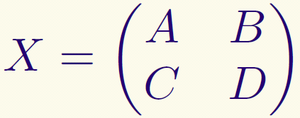
Construction of proofs
Construct circuits w/ division gates for inverse and determinant in block forms (gives poly-size circuits):
Notes:
Give the simple block construction

Slide 27
Construction of proofs
Prove statement about X⁻¹ and DET where:
1. Divisions gates allowed
2. Circuits have no depth bound

Slide 28
Structure of argument
Arithmetic proofs with division gates
Arithmetic world
Define DET naturally there
Homogenization: Eliminate high degree terms from proofs
Prove properties of DET
Eliminate division gates from proofs
Propositional world
Balance the circuits in proofs: O(log²n)-depth
NC²-Frege: Transform balanced proofs into propositional proofs (immediate)

Slide 29
Open problem
Uniform proofs of linear algebra!
Use the arithmetic setting to derive new upper/lower bounds for propositional proofs?

Slide 30
Thank you !

